Slide 1
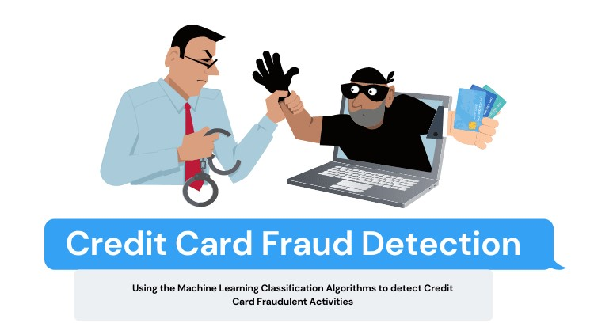
BIG IMAGE
Credit Card Fraud Detection
Using Machine Learning Classification Algorithms to detect Credit Card Fraudulent Activities

Slide 2

Credit Card Fraud Detection
An Automated Fraud Detection
Project
January 2024

Slide 3

What and Why
What is a Credit Card Fraud
Credit Card Fraud Detection is a major problem that financial world is facing now a days. Even greater problem is to detect the fraudsters and fraud transactions.
To tackle this we need AI to automate the process, because we, a humans, its merely impossible to search the fraud transactions in a short period of time. Now, we use Machine learning algorithms here to find the number of fraud transactions. It’s number is much lesser than the number of legitimate transaction for any bank.
Most approaches involve building models on such imbalanced data, and thus fails to produce results on real-time new data because of over fitting on training data which is bias towards the class of legitimate transactions (major class). Thus, we can see this as an anomaly detection problem.

Slide 4

2 MAJOR PROBLEMS
Here, I was asked with 2 of the major problems in anomaly.
Question.1: At what time does the Credit Card Frauds takes place usually?
Question.2: On legitimate transactions, how do we balance the data and don’t let it overfit?

Slide 5
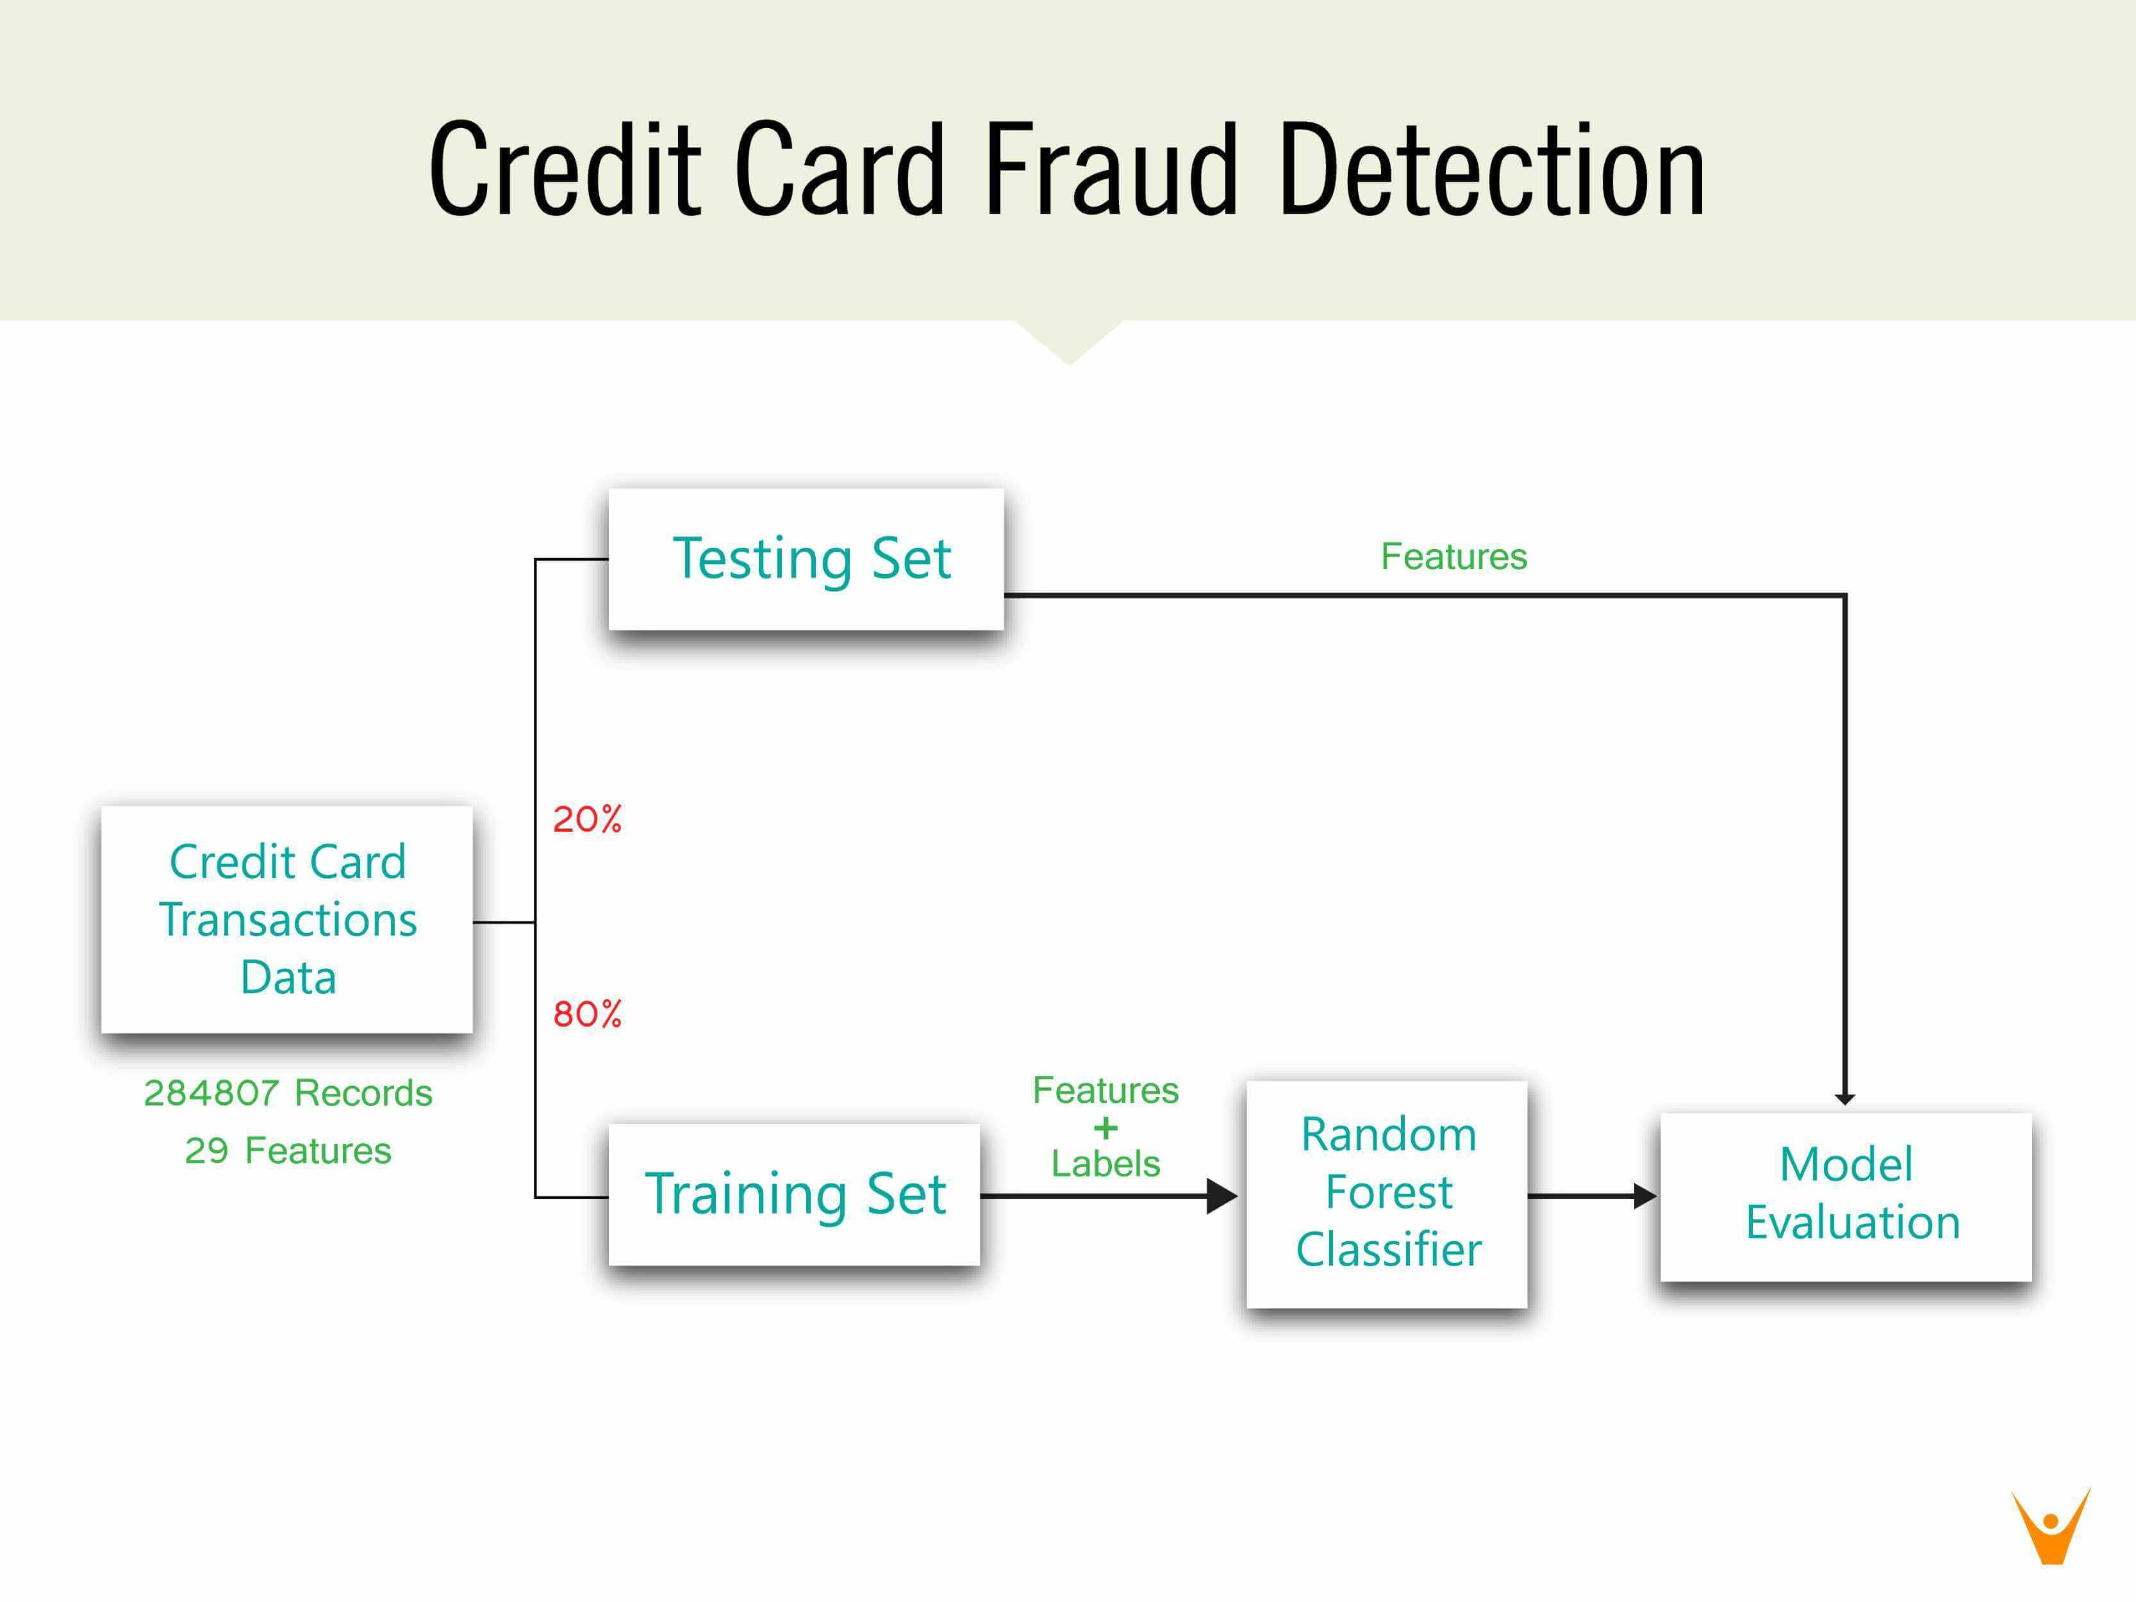

Slide 6
After Basic Data Processing
1 = Fraud Transactions
0 = Legitimate Transactions
Relationship of fraud transactions with amount of money
As we can see Dataset is highly imbalanced.
Major class label = 0 and minor class label 1.
Now, we will perform Synthetic Minority Oversampling on the data to balance it out.
Let us try to determine the nature of transactions – and lets find out if there is any connection between the time zone of the fraudsters - in the next slides.

Slide 7
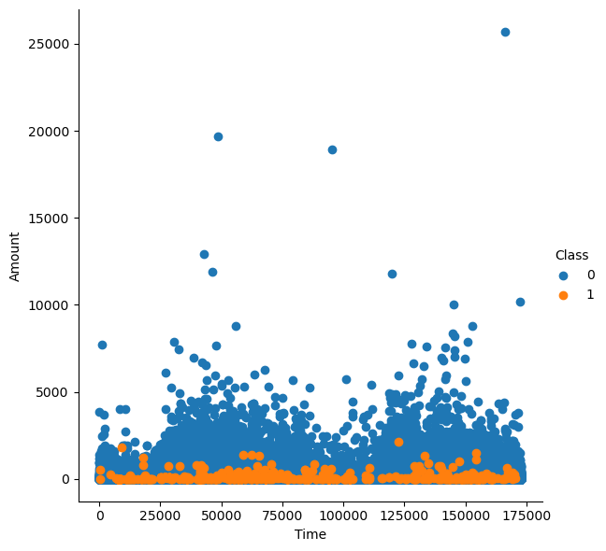
PAIRPLOT INSIGHTS
All Fraud Transactions occur for an amount below 2500.
Thus, the bank can infer clearly that the fraud committers try to commit frauds of smaller amounts to avoid suspicion
Legit Transactions
Fraud Transactions

Slide 8
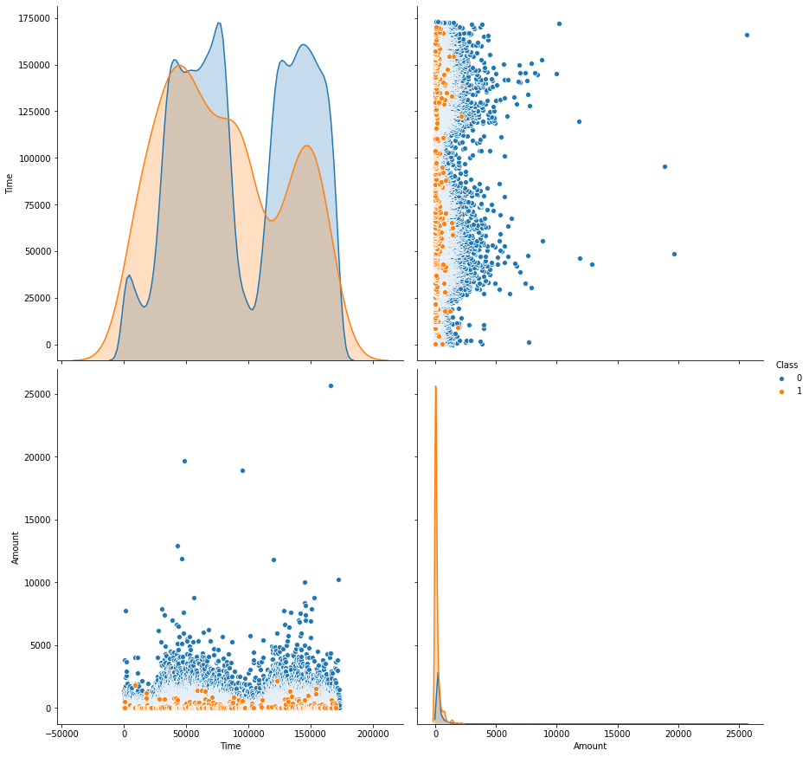
PAIRPLOT INSIGHTS
Legit Transactions
Fraud Transactions
The fraud transactions are generally not above an amount of 2500.
We observe that the 99.85% of transactions amount to less than 2500.
The fraud transactions are evenly distributed about time.
Number of Legit Transactions - 284315
Number of Fraud Transactions - 492

Slide 9
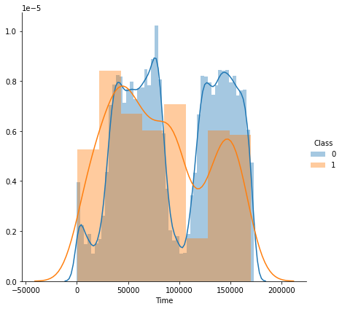
Relationship between Time and Transactions
From the distribution plot, it is clear that the fraudulent transactions are spread throughout the time period. Hence there is not evident proof that there is a direct relationship between Time and activity of Fraudsters.

Slide 10
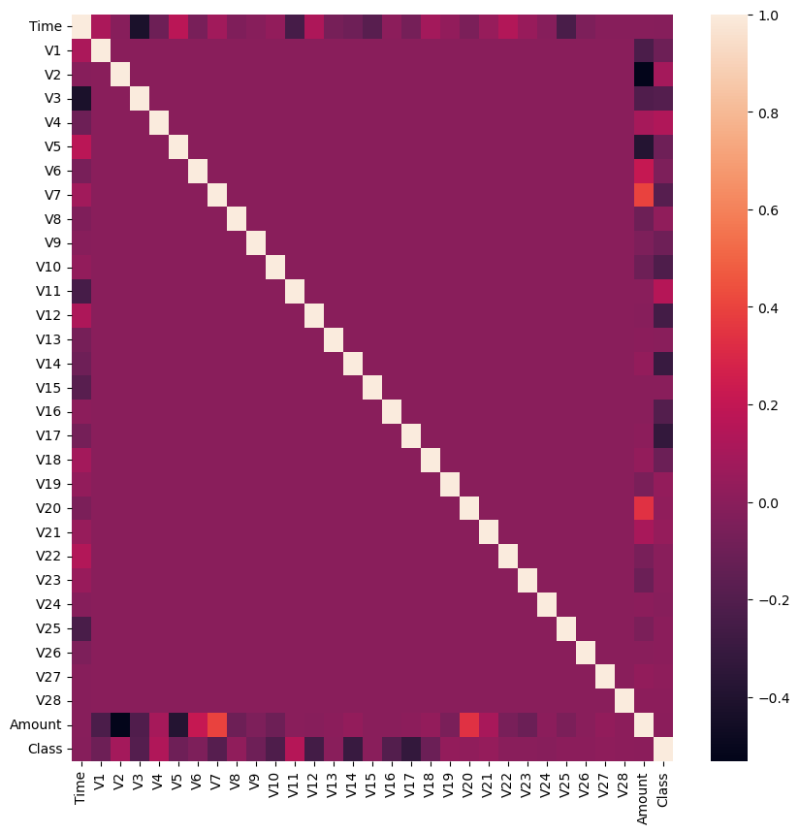
Feature Correlation in HEATMAPS
For studying the Feature Correlations of the given data.
Feature Selection
Identifying Relationships

Slide 11
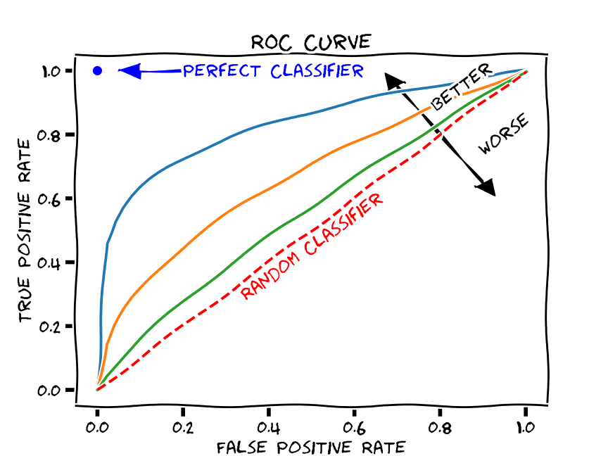
EVALUATION
We make use of AUC-ROC Score, Classification Report, Accuracy and F1-Score to evaluate the performance of the classifiers
Method to compute the following:
Classification Report
F1-score
AUC-ROC score
Accuracy
Parameters:
y_test: The target variable test set
grid_clf: Grid classifier selected
X_test: Input Feature Test Set

Slide 12
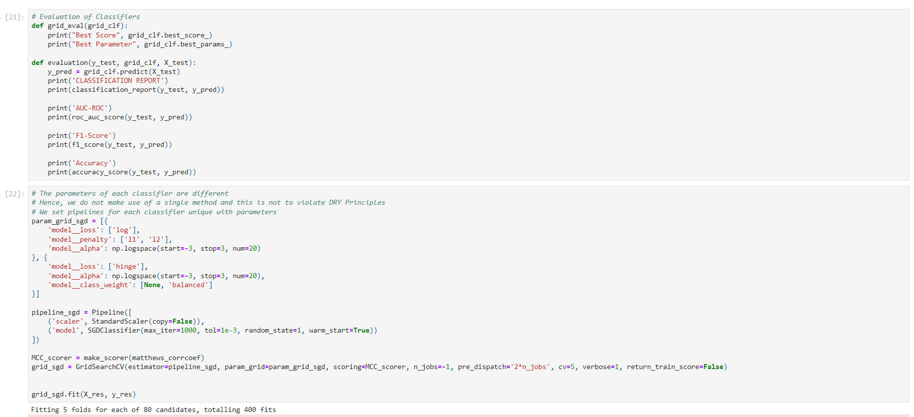
For performance of the classifiers:

Slide 13
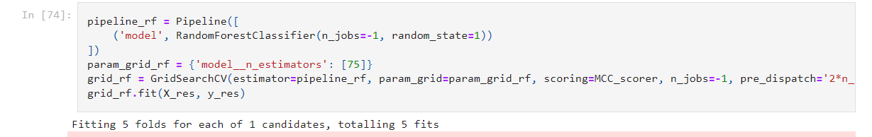
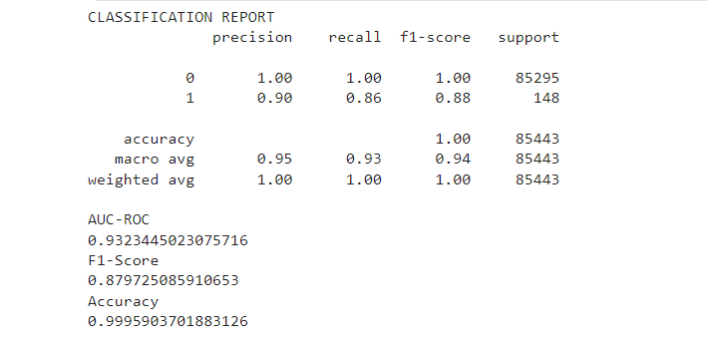
Pipeline for Random Forest Classifier

Slide 14
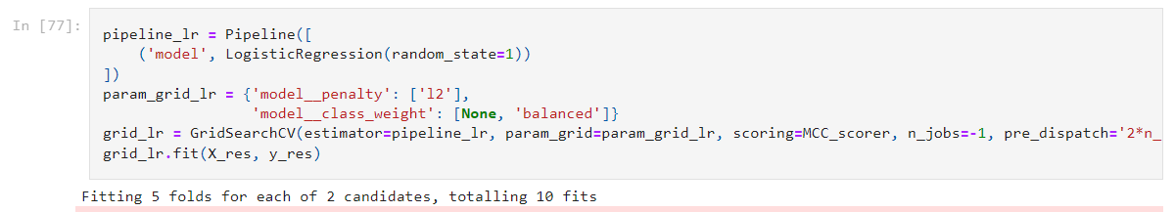
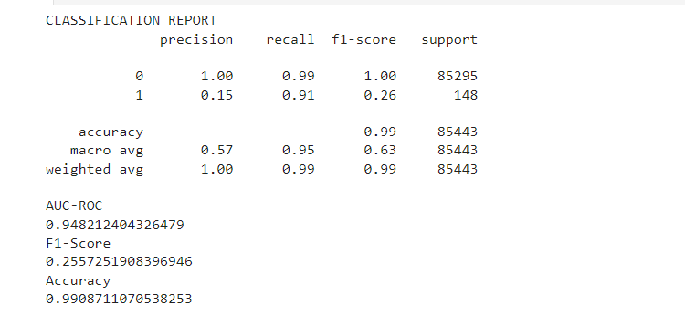
Pipeline for Logistic Regression

Slide 15
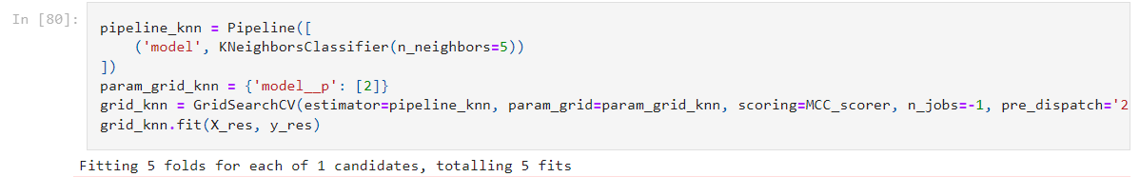
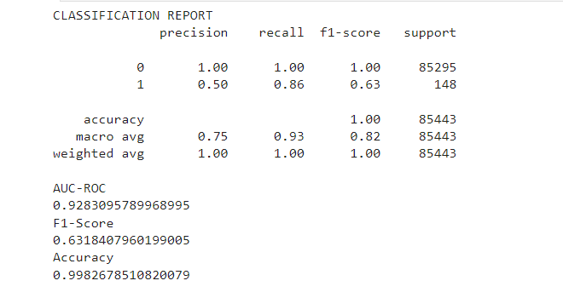
Pipeline for KN Neighbors Classifier

Slide 16
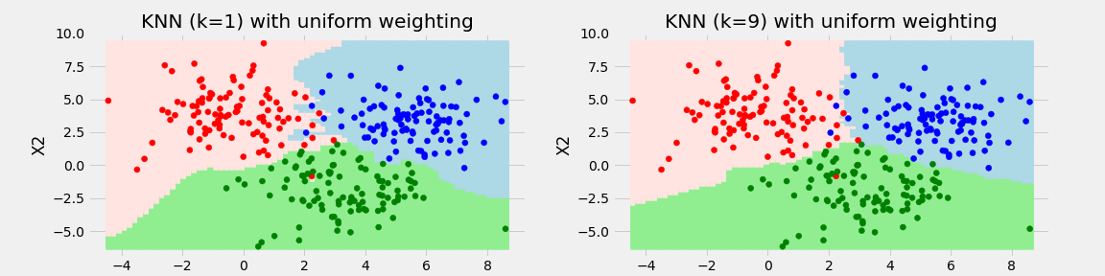
CONCLUSION
The K-Nearest Neighbors Classifier tuned with Grid Search with the best parameter being the Euclidean Distance (p=2) outperforms its counterparts to give a test accuracy of nearly 99.8% and a perfect F1-Score with minimal overfitting.
SMOTE overcomes overfitting by synthetically oversampling minority class labels and is successful to a great degree.

Slide 17
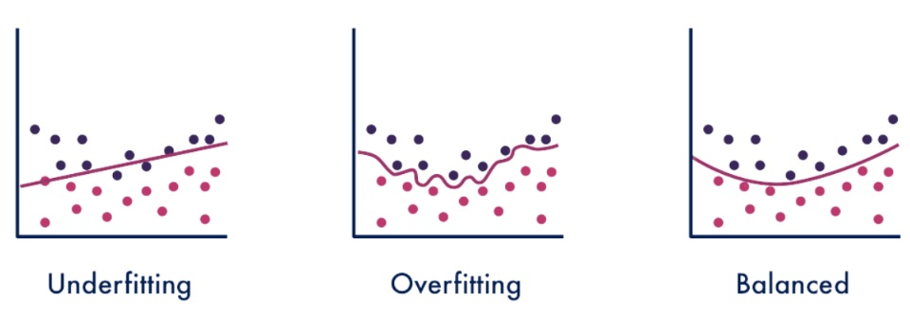
SUMMARY
All Fraud Transactions occur for an amount below 2500. Thus, the bank can infer clearly that the fraud committers try to commit frauds of smaller amounts to avoid suspicion.
The fraud transactions are equitable distributed throughout time and there is no clear relationship of time with committing of fraud.
The number of fraud transactions are very few compared to legitimate transactions and it has to be balanced in order for a fair comparison to prevent the model from overfitting.

Slide 18

THANK YOU!
Adhiraj Teotia
Phone:
+91-9582676944
Email:
adhiteo27@gmail.com

Slide 19
Other GitHub Project Links
https://github.com/adhirajteotia/Prediction-of-Credit-Card-fraud
https://github.com/adhirajteotia/Dashboard_healthcare
https://github.com/adhirajteotia/Tableau_superstore_dataset
https://github.com/adhirajteotia/Car_Price_Prediction_Python
https://github.com/adhirajteotia/Uncertainties-and-Controversies-in-the-recent-NFT-boom-using-SQL

